Slide 1


Slide 2

Content
Introduction
Where and How to Use Error Guessing
Factors used in Error Guessing Technique
Advantages of Error Guessing Technique
Disadvantages of Error Guessing Technique
Examples of Error Guessing in software testing
Conclusion

Slide 3
Content
Introduction
Where and How to Use Error Guessing
Factors used in Error Guessing Technique
Advantages of Error Guessing Technique
Disadvantages of Error Guessing Technique
Examples of Error Guessing in software testing
Conclusion

Slide 4
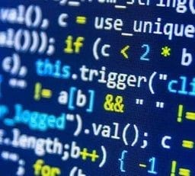
What is Error guessing ?
Error guessing is a type of testing method in which prior experience in testing is used to uncover the defects in software. It is an experience based test technique in which the tester uses his/her past experience or intuition to gauge the problematic areas of a software application

Slide 5
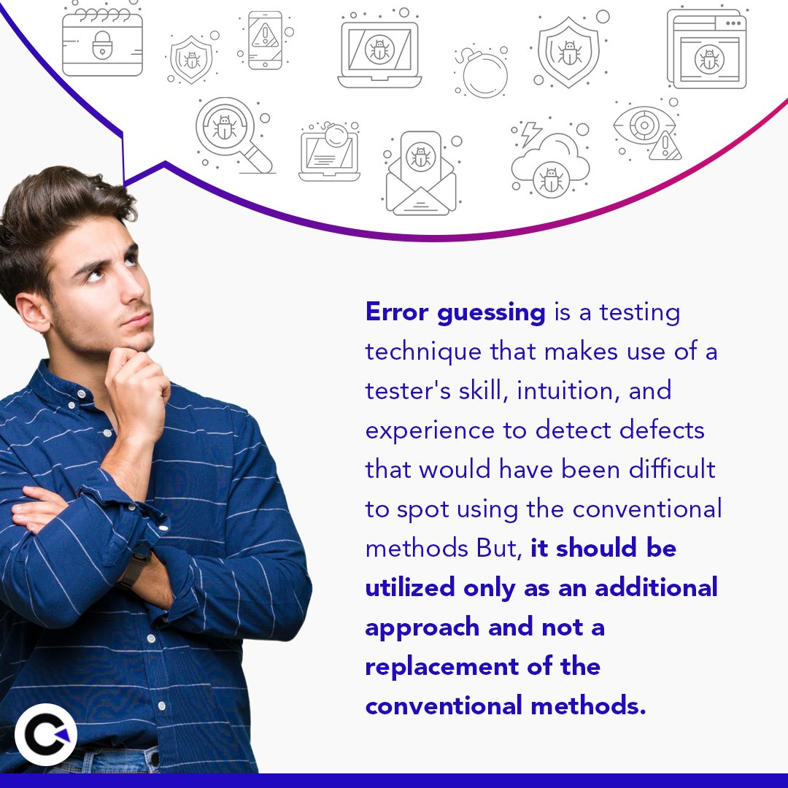
Where and How to Use Error Guessing
:
Time and Resource Constraints: Ideal for fast, efficient testing when resources or time are limited.
Agile and Adaptive Workplaces: Fits well in agile environments, where flexibility and iteration are key.
Unfamiliar or Complex Systems: Helps testers use their experience to identify potential issues in complex or poorly understood systems.
High-Risk Areas: Focuses testing efforts on critical, high-risk areas where errors can cause significant issues.

Slide 6
Factors used in Error Guessing Technique
Lessons learned from past releases.
Experience of testers.
Historical learning.
Test execution report.
Earlier defects.
Application UI.

Slide 7
Advantages of Error Guessing Technique:
It is effective when used with other testing approaches.
It is helpful to solve some complex and problematic areas of application.
It figures out errors which may not be identified through other formal testing techniques.
It helps in reducing testing times.

Slide 8
Disadvantages of Error Guessing Technique:
Only capable and skilled tests can perform.
Dependent on testers experience and skills.
Fails in providing guarantee the quality standard of the application.
Not an efficient way of error detection as compared to effort.
Never provide full coverage of an application

Slide 9
Examples of Error Guessing in software testing:
Blank Input:
Tester tries submitting a form without entering any data, expecting the system to show validation errors.
Invalid Data Format:
Entering alphabets in a numeric field or special characters in a name field to see if the application handles it properly.
Unexpected User Actions:
Double-clicking a submit button quickly to check for duplicate entries.
Incorrect Sequence of Operations:
Logging out and then clicking the back button to see if the user can still access protected pages.
Missing Mandatory Fields:
Trying to save a form while leaving required fields empty.

Slide 10
Conclusion
Error Guessing is one of the popular techniques of testing, even if it is not an accurate approach of performing testing still it makes the testing work simple and saves a lots of time. But when it is combined with other testing techniques we get better results.

Slide 11
THANK YOU….!!

